Slide 1
Sarah Smith Elementary School
Notes:
Good Morning/Afternoon! Today we begin the process of planning our school’s budget for FY21. I know we are all here for the same reason and that is ensuring success for all (enter school name) students. This meeting is to provide an overview of the draft budget and for you to give feedback on the draft budget.

Slide 2
Norms
This is a meeting of the GO Team. Only members of the team may participate in the discussion. Any members of the public present are here to quietly observe.
We will follow the agenda as noticed to the public and stay on task.
We invite and welcome contributions of every member and listen to each other.
We will respect all ideas and assume good intentions.

Slide 3
GO Team Budget Development Process
YOUR SCHOOL STRATEGIC PLAN…
is your roadmap and your role. It is your direction, your priorities, your vision, your present, your future.
Step 1: Data Review
Step 2: Strategic Plan Review
Step 3: Budget Parameters
Step 4: Budget Choices
Notes:
Today I will provide an overview of the budget allocations for FY21. We will begin the work of funding the strategic priorities we agreed upon during our strategic review meeting. (IF YOU HAVE NOT DECIDED ON YOUR PRIORITIES, YOU WILL SAY – WE WILL DECIDE ON OUR PRIORITIES AND THEN DISCUSS ALLOCATING FUNDS TO ADDRESS THOSE PRIORITIES).

Slide 4
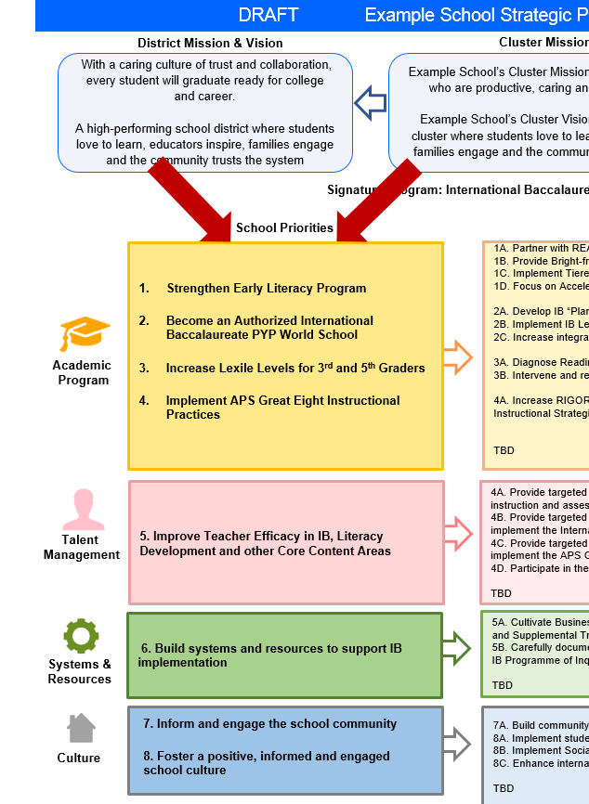
FY22 Budget Development Process
Principal’s Role
Design the budget and propose operational changes that can raise student achievement
Flesh out strategies, implement and manage them at the school level
Focus on the day-to-day operations
Serve as the expert on the school
Hire quality instructional and support personnel
The GO Team’s Role:
Focus on the big picture (positions and resources, not people)
Ensure that the budget is aligned to the school’s mission and vision and that resources are allocated to support key strategic priorities

Slide 5
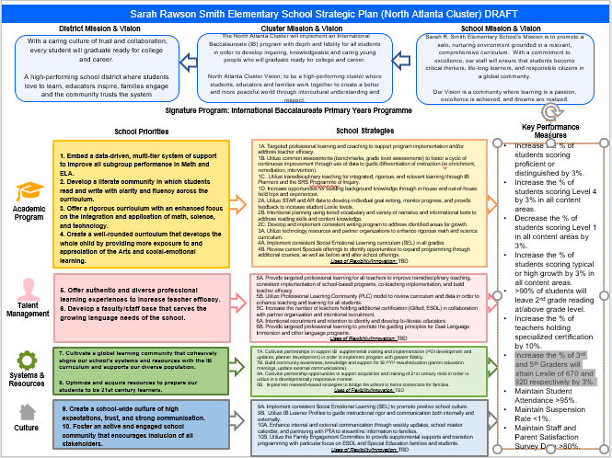
Sarah Smith Strategic Plan
Notes:
You should have a copy of our updated strategic plan (please make copies to be distributed to team).

Slide 6
FY22 Priorities & SMART Goals
(From your Strategic Plan, insert your Top 2 Priorities & SMART Goals for FY21 here)
School Priorities
SMART Goals
Embed a data-driven, multi-tier system of support to improve all subgroup performance in Math and ELA.
Increase the % of students scoring proficient or distinguished by 3%.
Increase the % of students scoring Level 4 by 3% in all content areas.
Decrease the % of students scoring Level 1 in all content areas by 3%.
Increase the % of students scoring typical or high growth by 3% in all content areas.
Develop a literate community in which students read and write with clarity and fluency across the curriculum.
90% of students will leave 2nd grade reading at/above grade level.
Increase the % of 3rd and 5th Graders will attain Lexile of 670 and 920 respectively by 3%.
Notes:
Discuss priorities and rationale

Slide 7
FY22 Budget Parameters
FY22 School Priorities | Rationale
Embed a data-driven, multi-tier system of support to improve all subgroup performance in Math and ELA. | For 2018-2019, students remained at about the same performance level in math and ELA, with more students shifting to the Distinguished category in math. We enjoyed the largest gains in Science and Social Studies, courses that integrate literacy and math skills. Our White and Hispanic students performed above the Challenge Index on the 2019 GMAS, but our Black students underperformed against this Challenge Index. Focus on this group is important for 2021-2022.
Develop a literate community in which students read and write with clarity and fluency across the curriculum. | For 2019-2020, Sarah Smith shifted our approach to literacy. Focusing on both fluency and comprehension K-2, we continue to build comprehension skills in grades 3-5. We continue to phase in Lucy Calkins writing. This is in response to our historical GMAS data indicating this is our weakest area in writing, and the difficulty in focusing on writing during virtual learning.
Notes:
Discuss priorities and rationale. After you have gone over the priorities and rationale – ask GO Team if this represents what was agreed upon.
Are there any priorities I left off?
Are there any questions or concerns?
The next time we meet, I will show you how I have allocated resources to support our strategic priorities.

Slide 8
Discussion of Budget Summary
(Step 4: Budget Choices)

Slide 9
Executive Summary
This budget represents an investment plan for our school’s students, employees and the community as a whole.
The budget recommendations are tied directly to the school’s strategic vision and direction.
The proposed budget for the general operations of the school are reflected at $ $7,974,777
This investment plan for FY21 accommodates a student population that is projected to be 817 students, which is a decrease of 84 students from FY21.
Notes:
Here’s a few highlights for our budget this year – read executive summary

Slide 10
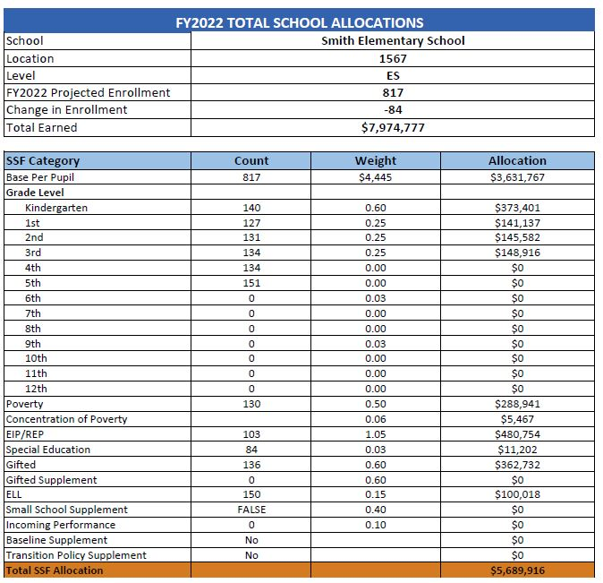
School Allocation
Notes:
For FY21, APS is continuing to increase equity within the District and the flexibility principals have in regards to our schools budgeted funds. The new Student Success Funding Model (SSF) allocates dollars to schools based on the number of enrolled students and receives a funding "weight" based on need. This year, student characteristics were weighted based on:
Grade Level –
K
1st through 3rd
6th
9th
Poverty – Weighted for all Direct Certification enrolled students.
Beginning Performance – Weighted Middle School and High School students entering with beginner’s performance on milestones.
ESOL – Weighted for all ESOL designated students in order to supplement due to ESOL staff being locked.
Special Education - Weighted for all Special Education students.
Gifted – Weighted and measured by number of students in the Gifted Program
Small School Supplement – Weighted for low enrollment schools
ES – 500
MS – 600
HS – 700
As you can see, our projected enrollment for FY19 is _______, we increased/decreased by __________ from last year.
We received the following weights for our student characteristics: (Below is just for the script, principals need to insert their school’s characteristics)
Grade Level
Poverty
Special Education
Gifted
Gifted Supplement
ELL
Small School Supplement

Slide 11
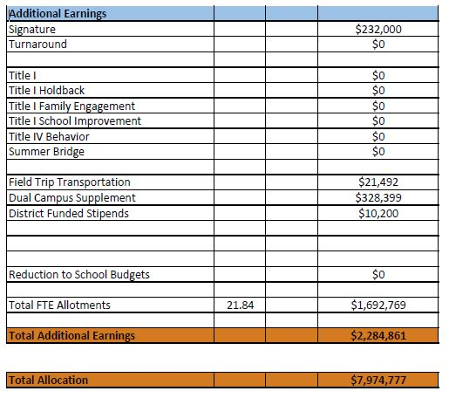
School Allocation
Notes:
Additionally, we received money for signature programming, turnaround, Title I and FTE Allotments.

Slide 12
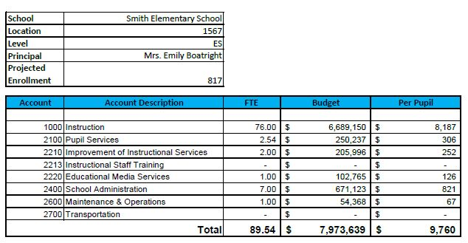
Budget by Function
Notes:
I am passing out the definitions for these funding categories. You will see what makes up each category. Although the total amount will not change, allocation per function may depending on our conversations and school needs.

Slide 13
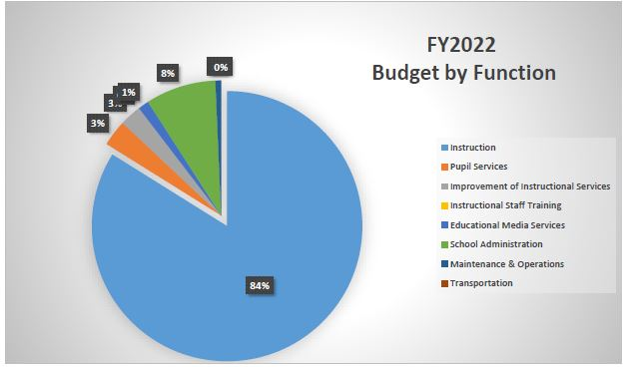
Budget by Function
Notes:
Explain the pie chart and allocations

Slide 14
What’s Next?
January:
GO Team Initial Budget Session (Jan. 21st-31st)
February:
One-on-one Associate Superintendent discussions
Cluster Planning Session (positions sharing, cluster alignment, etc.)
Program Manager discussions and approvals
GO Team Feedback Session
HR Staffing Conferences (February 24th - March 2nd)
• March:
Final GO Team Approval (March 3rd - March 13th)
Notes:
In February, we will meet again to discuss how the school’s budget has been allocated to support the programmatic needs and FY21 key strategic priorities.
If think we need to continue our budget conversations, we will schedule additional meetings. My goal is to make sure your voices are reflected in our school’s budget.
I will also be meeting with my Associate Superintendent, program managers and other key leaders to go over our budget and to make sure the school is meeting the standards of service and appropriately staffing.
During the week of Feb. 24th -March 2nd , HR Staffing Conferences will be held. At this meeting, I will present my plan for staff utilization, resource distribution and plan for staffing implications.
We will need to approve the budget at the ________ meeting.

Slide 15
Questions?
Thank you for your time and attention.
Notes:
IF YOU FEEL YOUR TEAM IS READY TO APPROVE THE DRAFT BUDGET, PLEASE DO SO. PLEASE REMIND THEM THAT YOU MAY NEED TO MEET WITH THEM AGAIN, IF THERE ARE CHANGES FROM YOUR MEETINGS WITH DISTRICT LEADERSHIP. LET THEM KNOW YOU WILL KEEP THEM INFORMED!!

Slide 16
Focus Area Descriptors
Strategic Plan Categories | District Descriptions of Categories
Academic Program | Our students will be well-rounded individuals who possess the necessary academic skills and knowledge and are excited about learning.
Talent Management | We will retain an energized and inspired team of employees who are capable of advancing ever-increasing levels of achievement for students of all backgrounds.
Systems & Resources | We will improve efficiency (productivity, cost, etc.) while also making decisions (including resource allocations) that are grounded in a strategic academic direction and data.
Culture | We will build trust with the community, and we will have engaged stakeholders (employees, students, parents, community members, partners, etc.) who are invested in the mission and vision and who support the creation of student-centered learning communities.
Notes:
I have printed the terms on the next two slides for your convenience. I want to just go over them so we will all be on the same page as we move forward in this process. If you have any questions, please don’t hesitate to ask.

Slide 17
Description of Strategy Categories
Budget Parameters – FY22 funding priorities from the school’s 3-5 year strategic plan, ranked by the order of importance
Strategies – Lays out specific objectives for schools improvement
Request – “The Ask”. What needs to be funded in order to support the strategy?

Slide 18
FY22 Budget Parameters
FY22 School Priorities | Rationale
Embed a data-driven, multi-tier system of support to improve all subgroup performance in Math and ELA. | The student body at Sarah Smith Elementary School is one of the most diverse in APS. Ensuring student needs are addressed along the continuum of services is crucial for continued school improvement. Small class sizes allow teachers to differentiate instruction and provide support based on students’ individual needs – crucial as we continue to address learning loss from the pandemic.
Develop a literate community in which students read and write with clarity and fluency across the curriculum. | Literacy development remains central to our school’s instructional program. Reading scores are higher in K-2, but drop in 3-5 as students must manipulate material more. Additional support here is crucial.
Optimize and acquire resources to prepare our students to be 21st century learners. | As additional instructional technologies continue to be utilized by the school, ensuring that students acquire digital citizenship skills is vital, along with a vertical progression of the school’s expectations regarding technology.
Offer a rigorous curriculum with an enhanced focus on the integration and application of math, science, and technology. | Student achievement in mathematics has increased over time, though it remains behind reading in K-2. Ensuring that all students develop conceptual understanding and fluency in the early years will help build stronger math students in grades 3-5.
Create a well-rounded curriculum that develops the whole child by providing more exposure to and appreciation of the Arts and social-emotional learning. | Providing sufficient Specials offerings that tap into various interests, along with support to address the diverse social and emotional needs of students can foster engagement and a sense of belonging for all.
Notes:
Review the priorities that the GO Team has developed and the rationale for these priorities

Slide 19
FY22 Budget Parameters
FY22 School Priorities | Rationale
Develop a faculty/staff base that serves the growing language needs of the school. | As an IB World School, we want to keep up the momentum from our recent IB reauthorization visit. Central to this is hiring qualified staff members to address the diverse language needs of students and of the IB Programme.
Offer authentic and diverse professional learning experiences to increase teacher efficacy. | Further job-embedded professional development that aligns with our strategic plan and priorities, as well as our signature plan, is necessary for continued academic success.
Foster an active and engaged school community that encourages inclusion of all stakeholders. | Ensuring inclusion among all stakeholders is key to raising achievement in any setting, particularly one as diverse as Sarah Smith. Ensuring different members of our school community has a voice will allow subgroup performance to grow.
Cultivate a global learning community that cohesively aligns our school’s systems and resources with the IB curriculum and supports our diverse population | Our IB Programming should ensure our diversity is capitalized upon as a potential strength. Continuing to develop efficacy in inquiry-based instruction will allow all populations to thrive.
Create a school-wide culture of high expectations, trust, and strong communication. | Strong schools begin with common expectations that align with the level of rigor required of the standards. As we believe all students can learn, we need to hold them accountable to rise to the occasion.
Notes:
Discuss priorities and rationale. After you have gone over the priorities and rationale – ask GO Team if this represents what was agreed upon.
Are there any priorities I left off?
Are there any questions or concerns?
The next time we meet, I will show you how I have allocated resources to support our strategic priorities.

Slide 20
FY22 Strategic Plan Break-out
Priorities | Focus Area | Strategies | Requests | Amount
Embed a data-driven, multi-tier system of support to improve all subgroup performance in Math and ELA. Develop a literate community in which students read and write with clarity and fluency across the curriculum. | Academics/ Talent Management | Utilize Professional Learning Community (PLC) model to plan for instruction and examine data in order to enhance teaching and learning for all students in alignment with our IB Signature Program. Utilize common assessments (benchmarks, grade level assessments) to foster a cycle of continuous improvement differentiation of instruction (i.e. enrichment, remediation, intervention) based in data. | Maintain reduced class sizes in all core content areas. Maintain staffing in Media Centers. | $3,012,285
Embed a data-driven, multi-tier system of support to improve all subgroup performance in Math and ELA. | Academics | Continue to provide differentiated curriculum based on students’ unique needs, including Special Education and English Language Learners. | Ensure sufficient staffing for ESOL and Special Education programming. Special Education Lead Teacher to support case loads at both campuses. | $1,201,689
Offer a rigorous curriculum with an enhanced focus on the integration and application of math, science, and technology. | Academics | Provide gifted load exempt teachers to support differentiation of instruction, resource gifted, and talent development opportunities for students who need additional rigor. | Ensure sufficient staffing for Gifted and Talent Development programming | $267,115
Offer authentic and diverse professional learning experiences to increase teacher efficacy | Talent Management | Utilize Professional Learning Community (PLC) model to plan for instruction and examine data in order to enhance teaching and learning for all students in alignment with our IB Signature Program. | Provide Instructional Coach to support teachers’ development of instructional strategies and data-driven instruction. Provide IB Coordinator to support IB training and implementation. | $ 205,996
Notes:
For the next few slides, I will show you how I have allocated the budget to support our strategic priorities.
Based on our strategic priorities and funds we received, here is a break-out of the priorities, which focus area it addresses, the strategies that will be implemented, the purchase request, which funding source was used and the amount.

Slide 21
FY21 Strategic Plan Break-out
Priorities | Focus Area | Strategies | Requests | Amount
Create a well-rounded curriculum that develops the whole child by providing more exposure to and appreciation of the Arts and social-emotional learning. | Academics/ Culture | Review current Specials offerings to identify opportunities to expand programming through additional courses, as well as before and after school offerings. | Purchase fine arts, music, and physical education teachers. Purchase portion of Social Worker, SEL teacher and school counselor. | $708,817
Develop a faculty/staff base that serves the growing language needs of the school. | Talent Managements | Intentional recruitment and retention to identify and develop bi-literate educators. | Maintain additional teacher for 5th grade DLI program expansion. Purchase paraprofessionals to support students in DLI. Purchase teachers to provide French instruction for all non-DLI classes 1st – 5th grades | $117,226
Foster an active and engaged school community that encourages inclusion of all stakeholders. | Systems and Resources | Implement research-based strategies to bridge the school to home connection for families. | Convert parent liaison to full-time position. | $42,017
Create a school-wide culture of high expectations, trust, and strong communication | Culture | Enhance internal and external communication through weekly updates, school master calendar, and partnering with PTA to streamline information to families. | Ensure appropriate support staffing to effectively communicate with a variety of stakeholders (students, parents, community, PTO, Foundation) in order to improve operations at the school level. | $154,689
Notes:
Based on our strategic priorities and funds we received, here is a break-out of the priorities, which focus area it addresses, the strategies that will be implemented, the purchase request, which funding source was used and the amount.

Slide 22
FY 2022: Purpose of Reserve Funds
To account for the district’s overall revenue uncertainty & help to mitigate potential losses at leveling
2% of school’s SSF allocation has been budgeted for Non-Staffing
Use of these funds is subject to District Approval
Notes:
The reserve can be impacted at two points in the budget process: 1. During the summer, dependent upon district revenues matching projections and 2. After the 15-day count for enrollment leveling.

Slide 23
Plan for FY22 Reserve
Priorities | Focus Area | Strategies | Requests | Amount
Develop a faculty/staff base that serves the growing language needs of the school. | Talent Managements Systems and Resources | Intentional recruitment and retention to identify and develop bi-literate educators. Implement research-based strategies to bridge the school to home connection for families. | Hire additional bi-lingual paraprofessional to support grades 3 -5th grades DLI | $28,188
Embed a data-driven, multi-tier system of support to improve all subgroup performance in Math and ELA. Develop a literate community in which students read and write with clarity and fluency across the curriculum. | Academics | Implement research-based strategies to bridge the school to home connection for families. Address learning loss due to the pandemic. | Hire teacher-tutors for supplemental tutoring after-school. | $30,000
Optimize and acquire resources to prepare our students to be 21st century learners. | Systems and Resources | Ensure teachers have the materials needed to implement IB Planners and core curriculum. Purchase supplemental resources to help address learning loss due to the pandemic. | Purchase materials, technology resources to supplement curriculum based on identified needs. | $55,610
Notes:
This slides represent the priorities we will fund if we receive additional money from Title I and the Leveling Reserve. When we approve the budget we will approve both so that we will not have to schedule another meeting if the funds are made available.
Before I turn it back over to the Chair for the next slide, I want to thank you for your hard work and support this year. I will keep you informed as we move through the budget process. (Please inform Chair that they will facilitate the discussion for the last slide)

Slide 24
Questions to Consider
Are our school’s priorities (from your strategic plan) reflected in this budget?
Are new positions and/or resources included in the budget to address our major priorities?
Do we know (as a team) the plan to support implementation of these priorities beyond the budget (ex. What strategies will be implemented)?
What tradeoffs are being made in order to support these priorities?
2. How are district and cluster priorities reflected in our budget?
Cluster priorities- what staff, materials, etc. are dedicated to supporting our cluster’s priorities?
Signature programs- what staff, materials, etc. are dedicated to supporting our signature program?
Are there positions our school will share with another school, i.e. nurse, counselor?
Notes:
CHAIR - Our final task for today! Here are questions that we need to consider to ensure we have a good working draft budget. Let’s walk through them together.

